Slide 1
Clustering Analysis Lab

Slide 2
K-Means Cluster Analysis

Slide 3
Example 1:
The dataset HVAC represents the home vacancy rate in the 50 states and District of Colombia over the period of 1986 to 2023.
Home vacancy rate is defined as the percentage of all available units in a rental property that are vacant or unoccupied at a particular time.
Gathered from the Federal Reserve Bank of St. Louis (FRED).
Note: If features (columns) have significantly different scales, it's generally recommended to normalize or standardize them.

Slide 4
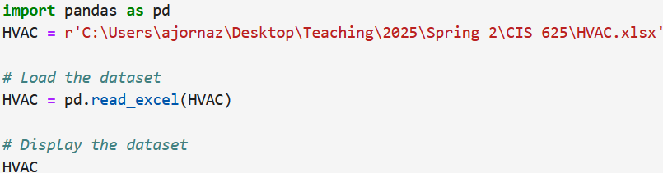
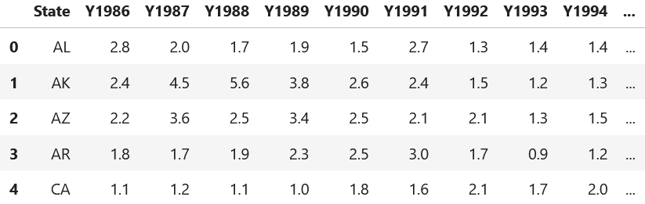
Import the dataset, and print out.

Slide 5

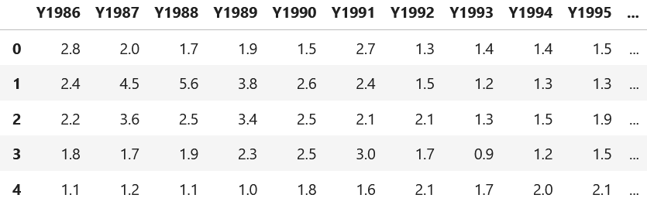
Select only the numeric columns in the dataset. (Remove State column).

Slide 6
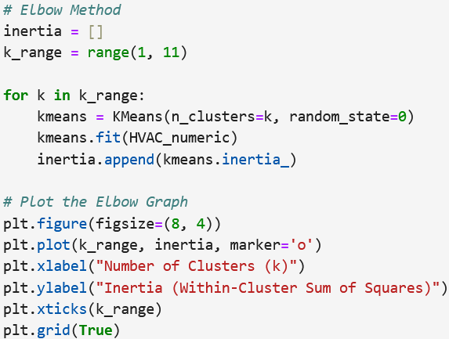
Find the optimal number of clusters using the elbow method.

Slide 7
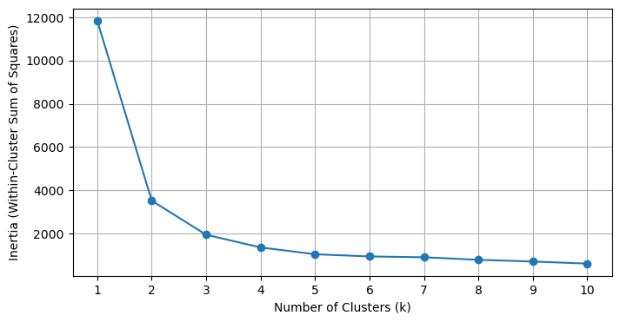
Figure 1 Elbow curve
Based on the Elbow method, the appropriate number of clusters is 3.

Slide 8
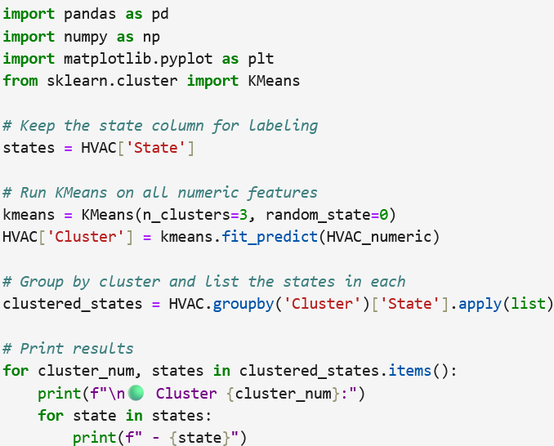
Use k-means clustering to group the data points into clusters.

Slide 9
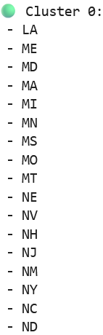
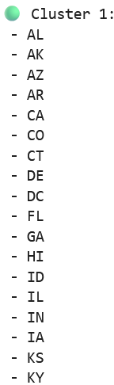
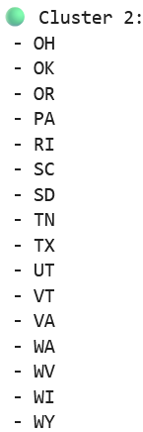
Figure 2 List of the three clusters

Slide 10
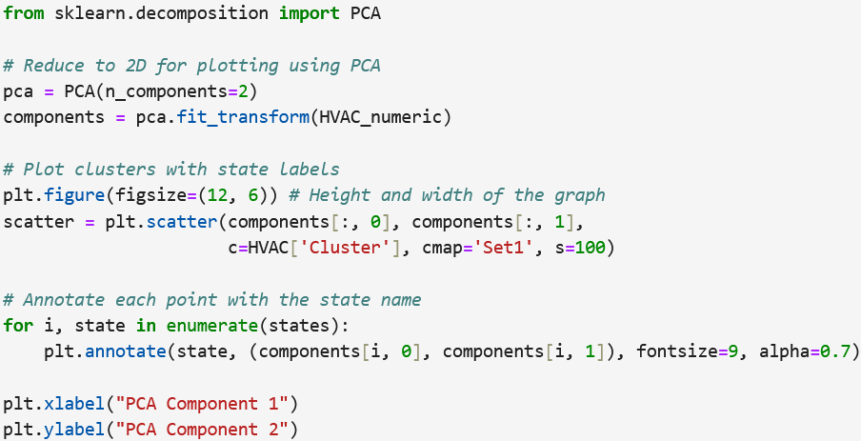
Using the principal component analysis, visualize the three clusters.

Slide 11
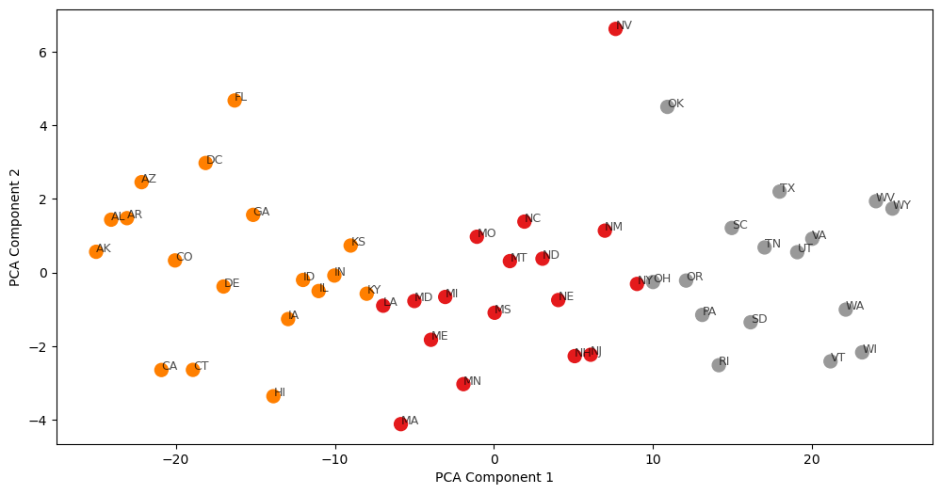
Figure 3 The cluster plot of the home vacancy rate

Slide 12
Hierarchical Clustering Analysis

Slide 13
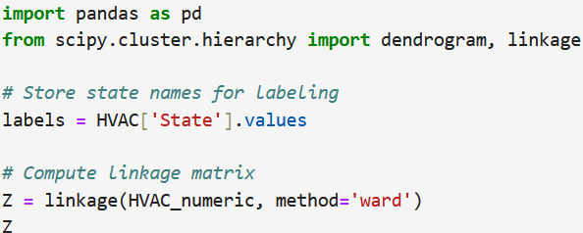
Example 2:
For the dataset HVAC (Home vacancy rate).
Perform Hierarchical clustering using Ward’s method.

Slide 14
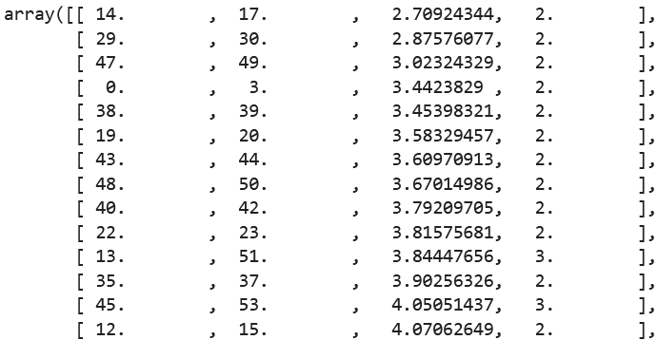
Figure 1 Elbow curve
IN and KY are most similar states and formed cluster 51. IL joined this cluster after 11 steps.

Slide 15
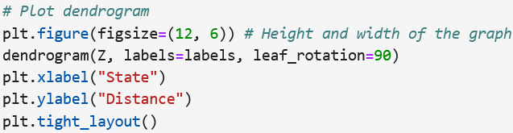
Visualize the dendrogram.

Slide 16
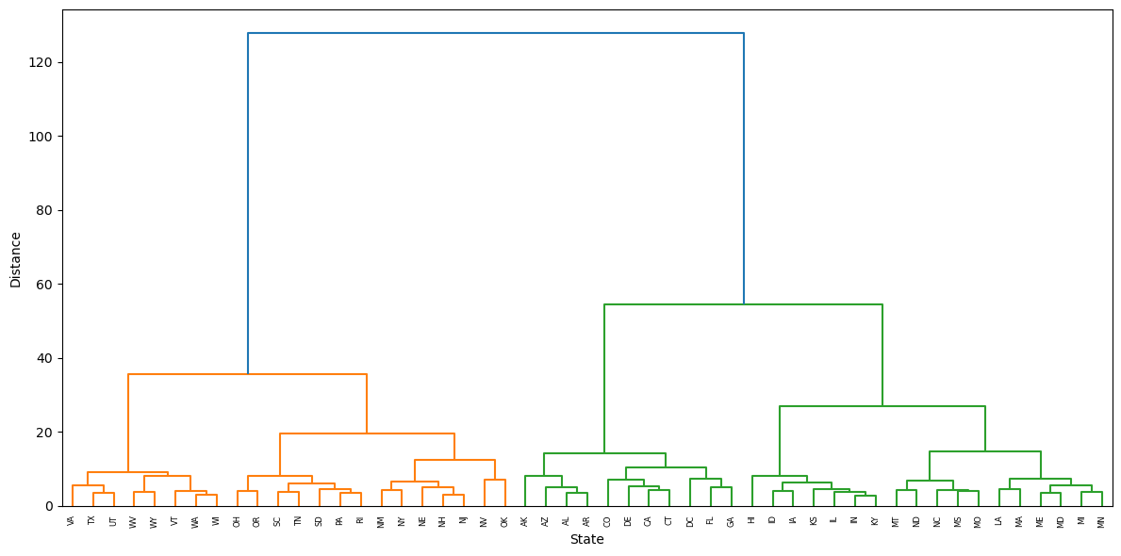
Figure 2 The dendrogram of the home vacancy rate

Slide 17
Practice:
The StateCrime2012 dataset contains seven variables that represent the number of crimes per 100,000 people in each of the fifty US states in 2012.
Perform K-Means clustering.
Perform Hierarchical clustering.
Note: If features (columns) have significantly different scales, it's generally recommended to normalize or standardize them.

